Slide 1
Module – 5 Fibre channel storage area network (FC SAN)
Module 5: Fibre Channel Storage Area Network
1
Notes:
Module – 5
Fibre Channel Storage Area Network (FC SAN)

Slide 2
Module 5: Fibre Channel Storage Area Network (FC SAN)
Upon completion of this module, you should be able to:
Describe FC SAN and its components
Describe FC architecture
Describe FC SAN topologies and zoning
Describe virtualization in SAN environment

Slide 3
Module 5: Fibre Channel Storage Area Network (FC SAN)
Lesson 1: Overview of FC SAN
During this lesson the following topics are covered:
Evolution of FC SAN
Components of FC SAN
FC interconnectivity options
FC port types

Slide 4
Business Needs and Technology Challenges
An effective information management solution must provide:
Just-in-time information to business users
Flexible and resilient storage infrastructure
Information management challenges in direct-attached storage (DAS) environment:
Explosive growth of information storage that remains isolated and underutilized
Proliferation of new servers and applications
Complexity in sharing storage resources across multiple servers
High cost of managing information
Storage area network (SAN) addresses these challenges

Slide 5
What is a SAN?
SAN
It is a high-speed, dedicated network of servers and shared storage devices.
Centralizes storage and management
Enables sharing of storage resources across multiple servers at block level
Meets increasing storage demands efficiently with better economies of scale
Common SAN deployments are:
Fibre Channel (FC) SAN: uses FC protocol for communication
IP SAN: uses IP-based protocols for communication

Slide 6
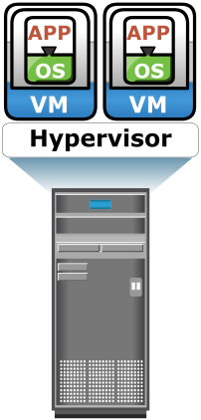
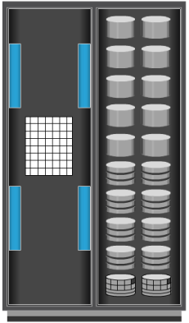



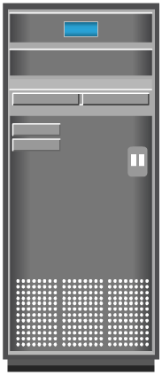
Understanding Fibre Channel
High-speed network technology
Latest FC implementation supports speed up to 16 Gb/s
Highly scalable
Theoretically, accommodate approximately 15 million devices
IP
Network
FC SAN
Clients
Application Servers
Storage Arrays

Slide 7
Components of FC SAN
Node (server and storage) ports
Cables
Connectors
Interconnecting devices such as FC switches and hubs
SAN management software

Slide 8
Node Ports
Provide physical interface for communicating with other nodes
Exist on
Host bus adapter (HBA) in server
Front-end adapters in storage
Full-duplex data transmission mode
Each port has a transmit (Tx) link and a receive (Rx) link
Node
Port 0
Tx
Rx
Port 0
Link
Port 1
Port n

Slide 9
Cables
SAN implementation uses
Copper cables for short distance
Optical fiber cables for long distance
Two types of optical cables: single-mode and multimode
Single-mode | Multimode
Carries single beam of light | Can carry multiple beams of light simultaneously
Distance up to 10km | Used for short distance (Modal dispersion weakens signal strength after certain distance )
Single-mode Fiber
Multimode Fiber

Slide 10
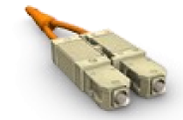
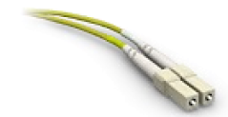
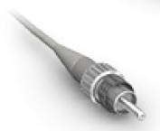
Connectors
Attached at the end of a cable
Enable swift connection and disconnection of the cable to and from a port
Commonly used connectors for fiber optic cables are:
Standard Connector (SC)
Duplex connectors
Lucent Connector (LC)
Duplex connectors
Straight Tip (ST)
Patch panel connectors
Simplex connectors
Standard Connector
Lucent Connector
Straight Tip Connector

Slide 11
Interconnecting Devices
Commonly used interconnecting devices in FC SAN are:
Hubs, switches, and directors
Hubs provide limited connectivity and scalability
Switches and directors are intelligent devices
Switches are available with fixed port count or modular design
Directors are always modular, and its port count can be increased by inserting additional 'line cards' or 'blades'
High-end switches and directors contain redundant components

Slide 12
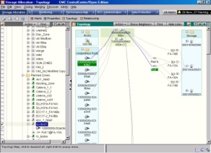
SAN Management Software
A suite of tools used in a SAN to manage interfaces between host and storage arrays
Provides integrated management of SAN environment
Enables web-based management using GUI or CLI

Slide 13
FC Interconnectivity Options
Point-to-Point
Fibre Channel Arbitrated Loop (FC-AL)
Fibre Channel Switched Fabric (FC-SW)

Slide 14
Point-to-Point Connectivity
Enables direct connection between nodes
Offers limited connectivity and scalability
Used in DAS environment
Servers
Server
Server
Storage Array

Slide 15
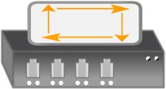
FC-AL Connectivity
Arbitrated loop
Provides shared loop to attached nodes
Nodes must arbitrate to gain control
Implemented using ring or star topology
Limitations of FC-AL
Only one device can perform I/O operation at a time
Supports up to 126 nodes
Addition or removal of a node causes momentary pause in loop traffic
Servers
Server
FC Hub
Storage Array

Slide 16
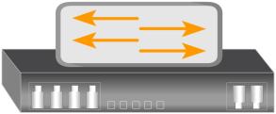
FC-SW Connectivity
Switched fabric
Creates a logical space (called fabric) in which all nodes communicate with one another using switches
Interswitch links (ISLs) enable switches to be connected together
Provides dedicated path between nodes
Addition/removal of node does not affect traffic of other nodes
Servers
Storage Array
FC Switch
FC Switch
Server
Interswitch Links

Slide 17
Port Types in Switched Fabric
Server
N-Port
F-Port
FC Switch
FC Switch
F-Port
E-Port
E-Port
F-Port
ISL
N-Port
N-Port
Storage Array
Storage Array

Slide 18
Module 5: Fibre Channel Storage Area Network (FC SAN)
Lesson 2: Fibre Channel (FC) Architecture
During this lesson the following topics are covered:
FC protocol stack
FC addressing
WWN addressing
Structure and organization of FC data
Fabric services
Fabric login types

Slide 19
FC Architecture Overview
Provides benefits of both channel and network technologies
Provides high performance with low protocol overheads
Provides high scalability with long distance capability
Implements SCSI over FC network
Transports SCSI data through FC network
Storage devices, attached to SAN, appear as local storage devices to host operating system

Slide 20
Fibre Channel Protocol Stack
Upper Layer Protocol
Example: SCSI, HIPPI, ESCON, ATM, IP
FC-4
Upper Layer Protocol Mapping
FC-2
Framing/Flow Control
FC-1
Encode/Decode
FC-0
1 Gb/s
2 Gb/s
4 Gb/s
8 Gb/s
16 Gb/s
FC Layer | Function | Features Specified by FC Layer
FC-4 | Mapping interface | Mapping upper layer protocol (e.g. SCSI) to lower FC layers
FC-3 | Common services | Not implemented
FC-2 | Routing, flow control | Frame structure, FC addressing, flow control
FC-1 | Encode/decode | 8b/10b or 64b/66b encoding, bit and frame synchronization
FC-0 | Physical layer | Media, cables, connector

Slide 21
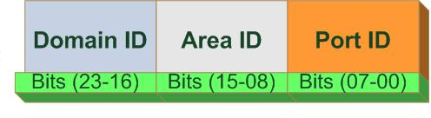
FC Addressing in Switched Fabric
FC Address is assigned to nodes during fabric login
Used for communication between nodes within FC SAN
Address format
Domain ID is a unique number provided to each switch in the fabric
239 addresses are available for domain ID
Maximum possible number of node ports in a switched fabric:
239 domains X 256 areas X 256 ports = 15,663,104

Slide 22
World Wide Name (WWN)
Unique 64 bit identifier
Static to node ports on an FC network
Similar to MAC address of NIC
WWNN and WWPN are used to uniquely identify nodes and ports respectively
World Wide Name - Array
5
0
0
6
0
1
6
0
0
0
6
0
0
1
B
2
0101
0000
0000
0110
0000
0001
0110
0000
0000
0000
0110
0000
0000
0001
1011
0010
Format
Type
Company ID
Port
Model Seed
24 bits
32 bits
World Wide Name - HBA
1
0
0
0
0
0
0
0
c
9
2
0
d
c
4
0
Format
Type
Reserved
Company ID
Company Specific
12 bits
24 bits
24 bits

Slide 23
Structure and Organization of FC Data
FC data is organized as Exchange, Sequence, and Frame
FC Data Structure | Description
Exchange | Enables two N_Ports to identify and manage a set of information units Information unit: upper layer protocol-specific information that is sent to another port to perform certain operation Each information unit maps to a sequence Includes one or more sequences
Sequence | Contiguous set of frames that correspond to an information unit
Frame | Fundamental unit of data transfer Each frame consists of five parts: SOF, frame header, data field, CRC, and EOF
SOF
Frame Header
Data Field
CRC
EOF
4 Bytes
24 Bytes
0 - 2112 Bytes
4 Bytes
4 Bytes
FC Frame

Slide 24
Fabric Services
FC switches provide fabric services as defined in FC standards
Fabric Services | Description
Fabric Login Server | Used during the initial part of the node’s fabric login process Located at pre-defined address of FFFFFE
Name Server | Responsible for name registration and management of node ports Located at pre-defined address FFFFFC
Fabric Controller | Responsible for managing and distributing Registered State Change Notifications (RSCNs) to attached node ports Responsible for distributing SW-RSCNs to every other switch SW-RSCNs keep the name server up-to-date on all switches Located at pre-defined address FFFFFD
Management Server | Enables FC SAN management using fabric management software Located at pre-defined address FFFFFA

Slide 25
Login Types in Switched Fabric
Fabric login (FLOGI)
Occurs between an N_Port and an F_Port
Node sends a FLOGI frame with WWN to Fabric Login Server on switch
Node obtains FC address from switch
Immediately after FLOGI, N_Port registers with Name Server on switch, indicating its WWN, port type, assigned FC address, etc.
N_Port queries name server about all other logged in ports
Port login (PLOGI)
Occurs between two N_Ports to establish a session
Exchange service parameters relevant to the session
Process login (PRLI)
Occurs between two N_Ports to exchange ULP related parameters

Slide 26
Module 5: Fibre Channel Storage Area Network (FC SAN)
Lesson 3: FC SAN Topologies and Zoning
During this lesson the following topics are covered:
Mesh and core-edge topologies
Benefits of zoning
Types of zoning

Slide 27
Mesh Topology
Full Mesh
FC Switches
Full mesh
Each switch is connected to every other switch
Maximum of one ISL or hop is required for host-to-storage traffic
Host and storage can be connected to any switch
Partial mesh
Not all the switches are connected to every other switch
Server
Storage Array
Partial Mesh
FC Switches
Server
Storage Array

Slide 28
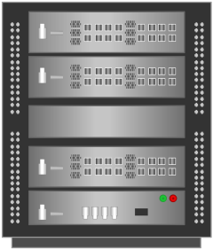
Core-edge Topology
Consists of edge and core switch tiers
Network traffic traverses core tier or terminate at core tier
Storage is usually connected to the core tier
Benefits
High availability
Medium scalability
Medium to maximum connectivity
Edge Tier
FC Switch
FC Switch
FC Switch
Server
FC Director
Core Tier
Storage Array
Edge Tier
FC Switch
FC Switch
FC Switch
Server
FC Director
FC Director
Storage Array
Core Tier

Slide 29
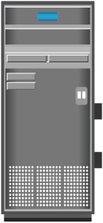
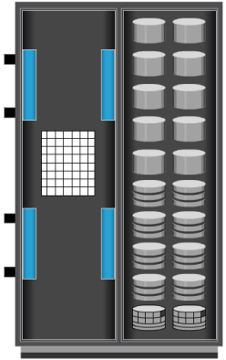
Zoning
Zoning
It is an FC switch function that enables node ports within the fabric to be logically segmented into groups, and communicate with each other within the group.
Zone set comprises zones
Each zone comprises zone members (HBA and array ports)
Benefits
Restricts RSCN traffic
Provides access control
Zone 1
Server
FC SAN
Storage Array
Array port
Zone 2
Servers
HBA Port

Slide 30
Types of Zoning
WWN Zoning
Uses World Wide Names to define zones
Zone members are the unique WWN addresses of the HBA and its targets (storage devices)
Allows nodes to be moved to another switch port in the fabric and maintain connectivity to its zone partners without having to modify the zone configuration

Slide 31
Types of Zoning
Servers
Switch Domain ID = 15
Port 5
Port 1
WWN 10:00:00:00:C9:20:DC:40
FC Switch
Storage Array
Port 9
Port 12
WWN 10:00:00:00:C9:20:DC:56
WWN 50:06:04:82:E8:91:2B:9E
Zone 1
WWN 10:00:00:00:C9:20:DC:82
Zone 1 (WWN Zone) = 10:00:00:00:C9:20:DC:82 ; 50:06:04:82:E8:91:2B:9E

Slide 32
Types of Zoning
Port Zoning
Uses the physical address of switch ports to define zones
Access to node is determined by the physical switch port to which a node is connected
Zone members are the port identifier (switch domain ID and port number) to which HBA and its targets (storage devices) are connected

Slide 33
Types of Zoning
Servers
Switch Domain ID = 15
Port 5
Zone 2
Port 1
WWN 10:00:00:00:C9:20:DC:40
FC Switch
Storage Array
Port 9
Port 12
WWN 10:00:00:00:C9:20:DC:56
WWN 50:06:04:82:E8:91:2B:9E
WWN 10:00:00:00:C9:20:DC:82
Zone 2 (Port Zone) = 15,5 ; 15,12

Slide 34
Types of Zoning
Mixed Zoning
Combines the qualities of both WWN zoning and port zoning
Using mixed zoning enables a specific node port to be tied to the WWN of another node

Slide 35
Types of Zoning
Servers
Switch Domain ID = 15
Port 5
Port 1
WWN 10:00:00:00:C9:20:DC:40
FC Switch
Storage Array
Port 9
Port 12
Zone 3
WWN 10:00:00:00:C9:20:DC:56
WWN 50:06:04:82:E8:91:2B:9E
WWN 10:00:00:00:C9:20:DC:82
Zone 3 (Mixed Zone) = 10:00:00:00:C9:20:DC:56 ; 15,12

Slide 36
Module 5: Fibre Channel Storage Area Network (FC SAN)
Lesson 4: Virtualization in SAN
During this lesson the following topics are covered:
Block-level storage virtualization
Virtual SAN

Slide 37
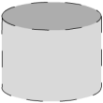

Block-level Storage Virtualization
Provides a virtualization layer in SAN
Abstracts block storage devices and creates a storage pool by aggregating LUNs
Virtual volumes are created from storage pool and assigned to hosts
Virtualization layer maps virtual volumes to LUNs
Benefits
Online volume expansion
Nondisruptive migration
Servers
Server
FC SAN
Virtual Volume
Virtualization
Appliance
LUN
Storage Pool
LUN
LUN
LUN
Storage Array
Storage Array

Slide 38

Use Case: Block-level Storage Virtualization across Data Centers
Data Center 1
Data Center 2
Servers
Servers
Server
Server
Virtual
Volumes
Virtual
Volumes
Virtualization Appliance
FC or IP
FC SAN
FC SAN
Virtualization Layer
Storage Arrays
Storage Arrays

Slide 39
Virtual SAN (VSAN)/Virtual Fabric
VSAN
It is a logical fabric on an FC SAN, enabling communication among a group of nodes, regardless of their physical location in the fabric.
VSAN 10
VSAN 20
Servers
Servers
Server
Server
Each VSAN has its own fabric services (name server, zoning), configuration, and set of FC addresses
VSANs improve SAN security, scalability, availability, and manageability
FC SAN
Storage Array
Storage Array

Slide 40
Module 5: Fibre Channel Storage Area Network (FC SAN)
Concept in Practice:
EMC Connectrix
EMC VPLEX

Slide 41
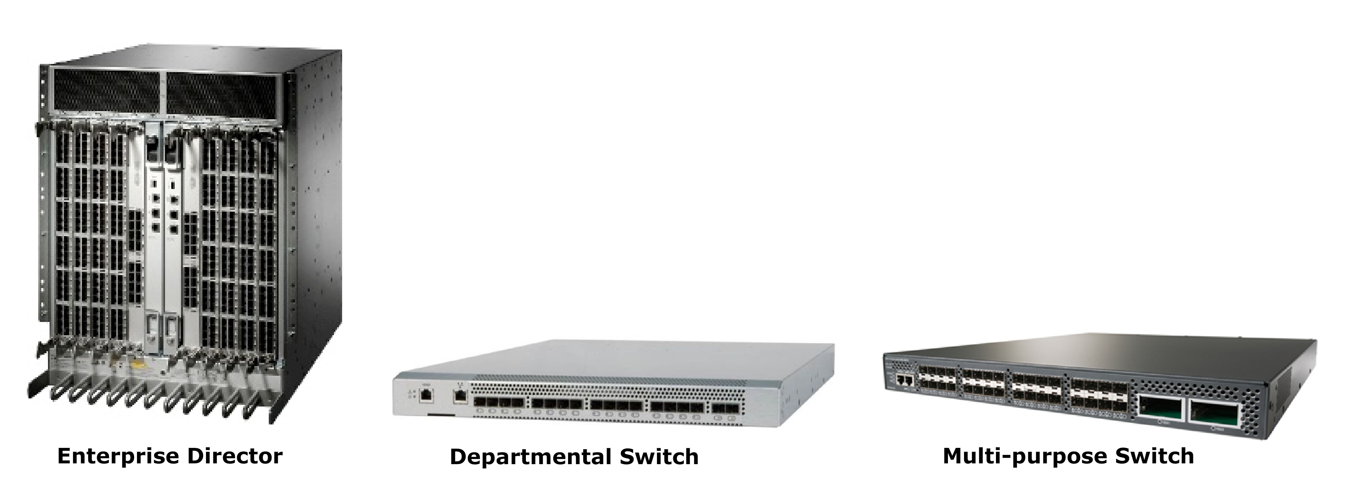
EMC Connectrix
Connectrix family includes networked storage connectivity products
Offers high-speed FC connectivity, highly resilient switching technology, intelligent IP storage networking, and I/O consolidation with Fibre Channel over Ethernet
Connectrix family consist of enterprise directors, departmental switches, and multi-purpose switches

Slide 42
EMC VPLEX
Provides solution for block-level storage virtualization and data mobility – both within and across data centers
Enables multiple hosts located across two locations to access a single copy of data
Provides capability to mirror a virtual volume – both within and across locations
Allows hosts at different data centers to simultaneously access cache-coherent copies of the same virtual volume
VPLEX family consists of three products
VPLEX Local
VPLEX Metro
VPLEX Geo

Slide 43
Module 5: Summary
Key points covered in this module:
FC SAN components and connectivity options
FC protocol stack and addressing
Structure and organization of FC data
Fabric services
Fabric topologies
Types of zoning
Block-level storage virtualization and virtual SAN

Slide 44
Exercise: FC SAN
Current situation
An organization’s IT infrastructure consists of three storage arrays direct-attached to a heterogeneous mix of 45 servers
Servers are dual-attached to the arrays to ensure high availability
Each storage array has 32 front-end ports, which could support maximum of 16 servers
Each storage array has the disk capacity to support a maximum of 32 servers

Slide 45
Exercise: FC SAN (contd..)
Organization’s challenges/requirements
Organization needs to deploy additional 45 servers to meet growth requirements
Existing storage arrays are poorly utilized and adding of new servers require to purchase new arrays
Organization wants to implement FC SAN to overcome the scalability and utilization challenges
Hop count must be minimized to meet performance requirement
Task
Propose a FC switched fabric topology to address organization’s challenges/requirements and justify your choice
If 72-port FC switches are available, determine the minimum number of switches required in the fabric

